Slide 1

Azure Pipelines
Mihai Budurescu – DevSchool Program
September 2024

Slide 2
Agenda
Day 1
    Presentation
    Understanding pipelines and their purpose
    Azure Pipelines key basics and structure
    Labs:
      Azure starter pipeline
      Multistage pipeline – Python to Azure Web App
    Q&A
    Day 2
    Templates and conditions
    Approvals and checks
    Another Lab ☺
    Menti evaluation

Slide 3
Why Azure Pipelines?
Accelerating application development and deployment lifecycles.
Building quality and consistency into an automated build and release process.
Increasing application stability and uptime.
Benefits:
Works with any language or platform: Node.js, Python, Java, PHP, Ruby, C#, C++, Go, XCode, .NET, Android, and iOS applications.
Deploys to different types of targets at the same time.
Integrates with Azure deployments.
Builds on Windows, Linux, or Mac machines.
Integrates with GitHub.
Azure Pipelines New User Guide - Key concepts - Azure Pipelines | Microsoft Learn

Slide 4
Before a pipeline we need to have a repository
Azure Pipelines and Azure DevOps Server integrate with a number of version control systems. When you use any of these version control systems, you can configure a pipeline to build, test, and deploy your application.
Repository type | Azure Pipelines (YAML) | Azure Pipelines (classic editor) | Azure DevOps Server 2022, 2020, 2019
Azure Repos Git | Yes | Yes | Yes
Azure Repos TFVC | No | Yes | Yes
GitHub | Yes | Yes | No
GitHub Enterprise Server | Yes | Yes | Yes
Bitbucket Cloud | Yes | Yes | No
Bitbucket Server | No | Yes | Yes
Subversion | No | Yes | Yes

Slide 5
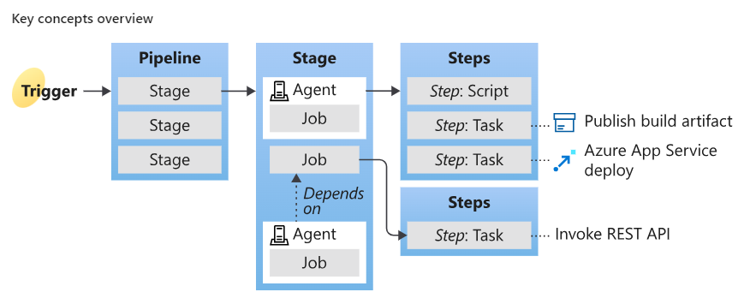
Pipelines structure
https://www.microsoft.com/en-us/videoplayer/embed/RWMlMo?postJsllMsg=true
Azure Pipelines New User Guide - Key concepts - Azure Pipelines | Microsoft Learn

Slide 6
Pipeline basics
A trigger tells a pipeline to run.
A pipeline is made up of one or more stages. A pipeline can deploy to one or more environments.
A stage is a way of organizing jobs in a pipeline and each stage can have one or more jobs.
Each job runs on one agent. A job can also be agentless.
Each agent runs a job that contains one or more steps.
A step can be a task or script and is the smallest building block of a pipeline.
A task is a prepackaged script that performs an action, such as invoking a REST API or publishing a build artifact.
An artifact is a collection of files or packages published by a run.
Azure Pipelines New User Guide - Key concepts - Azure Pipelines | Microsoft Learn

Slide 7
About pools and agents.
What is a parallel job?
      When you define a pipeline, you can define it as a collection of jobs. When a pipeline runs, you can run multiple jobs as part of that pipeline. Each running job consumes a parallel job that runs on an agent. When there aren't enough parallel jobs available for your organization, the jobs are queued up and run one after the other.
      In Azure Pipelines, you can run parallel jobs on Microsoft-hosted infrastructure or your own (self-hosted) infrastructure. Each parallel job allows you to run a single job at a time in your organization. You don't need to pay for parallel jobs if you're using an on-premises server. The concept of parallel jobs only applies to Azure DevOps Services.
Microsoft-hosted vs. self-hosted parallel jobs
    If you want to run your jobs on machines that Microsoft manages, use Microsoft-hosted parallel jobs. Your jobs will run on Microsoft-hosted agents.
    If you want Azure Pipelines to orchestrate your builds and releases, but use your own machines to run them, use self-hosted parallel jobs. For self-hosted parallel jobs, you'll start by deploying our self-hosted agents on your machines. You can register any number of these self-hosted agents in your organization.

Slide 8
Define pipelines using YAML
Your pipeline configuration resides in a YAML file named azure-pipelines.yml, alongside your application.
The YAML file is versioned alongside your application code, adhering to the same branching structure.
Each branch can customize the pipeline by editing the azure-pipelines.yml file.
Keeping the pipeline configuration in version control ensures that any changes that cause issues or unexpected outcomes can be easily identified within your codebase.
YAML is a popular programming language because it is designed to be easy to read and understand.
Popular tools using YAML: AzureDevops, Ansible, Kubernetes, Docker, Jenkins, etc.

Slide 9
Sample pipeline yaml file
parameters: #pass values to a pipeline
variables: #assign a value and use it in different part of the pipeline
trigger: #Use triggers to run a pipeline automatically
pool: #To build your code or deploy your software using Azure Pipelines, you need at least one agent, which belongs to a pool.
resources: #A resource is anything used by a pipeline that lives outside the pipeline. Ex: another pipeline, repository or variable groups.
stages: #logical boundary in the pipeline to separate environments and contains one or more jobs
- stage:
jobs: #if a stage contains more than one job, jobs keyword must be used
- job: # a job is a series of steps that run sequentially as a unit
steps: #block containing the steps to be executed
# a step can be a script or a task, smallest building block of a pipeline
- script:
- task:

Slide 10
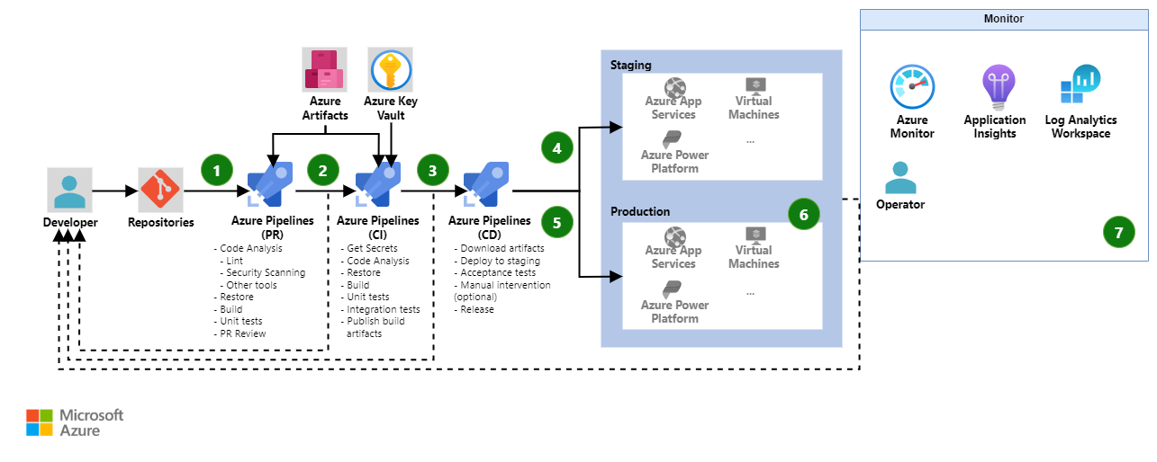
Azure Pipelines CI/CD architecture
Notes:
PR pipeline - A pull request (PR) to Azure Repos Git triggers a PR pipeline. This pipeline runs fast quality checks. These checks should include:
Building the code, which requires pulling dependencies from a dependency management system.
The use of tools to analyze the code, such as static code analysis, linting, and security scanning
Unit tests
If any of the checks fail, the pipeline run ends and the developer will have to make the required changes. If all checks pass, the pipeline should require a PR review. If the PR review fails, the pipeline ends and the developer will have to make the required changes. If all the checks and PR reviews pass, the PR will successfully merge.
CI pipeline - A merge to Azure Repos Git triggers a CI pipeline. This pipeline runs the same checks as the PR pipeline with some important additions. The CI pipeline runs integration tests. These integration tests shouldn't require the deployment of the solution, as the build artifacts haven't been created yet. If the integration tests require secrets, the pipeline gets those secrets from Azure Key Vault. If any of the checks fail, the pipeline ends and the developer will have to make the required changes. The result of a successful run of this pipeline is the creation and publishing of build artifacts
CD pipeline trigger - The publishing of artifacts triggers the CD pipeline.
CD release to staging - The CD pipeline downloads the build artifacts that are created in the CI pipeline and deploys the solution to a staging environment. The pipeline then runs acceptance tests against the staging environment to validate the deployment. If any acceptance test fails, the pipeline ends and the developer will have to make the required changes. If the tests succeed, a manual validation task can be implemented to require a person or group to validate the deployment and resume the pipeline.
CD release to production - If the manual intervention is resumed, or there's no manual intervention implemented, the pipeline releases the solution to production. The pipeline should run smoke tests in production to ensure the release is working as expected. If a manual intervention step results in a cancel, the release fails, or the smoke tests fail, the release is rolled back, the pipeline ends and the developer will have to make the required changes.
Monitoring - Azure Monitor collects observability data such as logs and metrics so that an operator can analyze health, performance, and usage data. Application Insights collects all application-specific monitoring data, such as traces. Azure Log Analytics is used to store all that data.

Slide 11
Runtime Parameters
Runtime parameters let you have more control over what values can be passed to a pipeline.
With runtime parameters you can:
    Supply different values to scripts and tasks at runtime
    Control parameter types, allowed ranges, and defaults
    Dynamically select jobs and stages with template expressions
    You can specify parameters in templates and in the pipeline. Parameters have data types such as number and string, and they can be restricted to a subset of values. The parameters section in a YAML defines what parameters are available.
    Parameters are only available at template parsing time. Parameters are expanded just before the pipeline runs so that values surrounded by ${{ }} are replaced with parameter values. Use variables if you need your values to be more widely available during your pipeline run.

Slide 12
Parameters different types
parameters:
- name: myString # Define a parameter named 'myString’
type: string # The parameter type is string
default: a string # Default value is 'a string'
- name: myMultiString # Define a parameter named 'myMultiString’
type: string # The parameter type is string
default: default # Default value is 'default’
values: # Allowed values for 'myMultiString’
- default
- ubuntu
- name: myBoolean # Define a parameter named 'myBoolean’
type: boolean # The parameter type is boolean
default: true # Default value is true

Slide 13
Runtime parameters sample file
parameters: #Parameters must contain name, data type, default value and declared at beginning of a YAML
- name: image
displayName: Pool Image
type: string
default: ubuntu-latest
values:
- windows-latest
- ubuntu-latest
trigger: none
jobs:
- job: build
displayName: build
pool:
vmImage: ${{ parameters.image }} #Parameters are expanded before the pipeline runs with syntax ${{ }}
steps:
- script: echo building $(Build.BuildNumber) with ${{ parameters.image }}

Slide 14
Variables
Variables scopes:
        At the root level, to make it available to all jobs in the pipeline.
        At the stage level, to make it available only to a specific stage.
        At the job level, to make it available only to a specific job.
When you define a variable at the top of a YAML, the variable is available to all jobs and stages in the pipeline and is a global variable. Global variables defined in a YAML aren't visible in the pipeline settings UI.
Variables at the job level override variables at the root and stage level. Variables at the stage level override variables at the root level. By default, each stage in a pipeline depends on the one just before it in the YAML file. Therefore, each stage can use output variables from the prior stage.
  Getting their values can be made with different syntax and the output can be different as well:
        ${{ variables.var }} -> get processed at compile time before pipeline is starting
        $(var) -> get processed during runtime before a task runs

Slide 15
Variables sample file
variables:
- name: one
value: initialValue
steps:
- script: |
echo ${{ variables.one }}
echo $(one)
displayName: First variable pass
- bash: echo "##vso[task.setvariable variable=one]secondValue"
displayName: Set new variable value
- script: |
echo ${{ variables.one }}
echo $(one)
displayName: Second variable pass

Slide 16
Predefined variables
These variables are automatically set by the system and read-only.
Types: Agent variables, Build variables, System variables
Examples:
$(Build.BuildId) - The ID of the record for the completed build.
$(Build.ArtifactStagingDirectory) – The local path on the agent where any artifacts are copied to before being pushed to their destination. For example: c:\agent_work\1\a. A typical way to use this folder is to publish your build artifacts with the Copy files and Publish build artifacts tasks.
$(System.DefaultWorkingDirectory) - The local path on the agent where your source code files are downloaded. For example: c:\agent_work\1\s
$(Pipeline.Workspace) - Workspace directory for a particular pipeline. This variable has the same value as Agent.BuildDirectory. For example, /home/vsts/work/1. Here the artifacts produced in the build stage will be downloaded automatically in a deployment job.

Slide 17
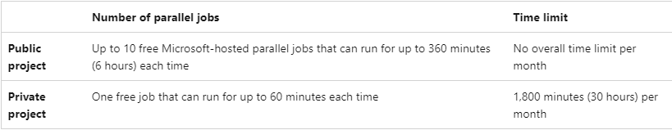
Parallel jobs covered by free tier
Remember: if your organization has a single parallel job, you can run a single job at a time for all the projects.
Microsoft provides a free tier of service by default in every new organization that includes at least one parallel job, but this is disabled by default. More details here.
For enabling submit this request: https://aka.ms/azpipelines-parallelism-request
It can take about 2-3 business days for the grant to be activated.
You can see the allocation in dev.azure.com/[your_organization] - > Organization settings -> Parallel jobs.

Slide 18
Lab1 – Starter pipeline
Prerequisites:
An Azure account with an active subscription. Create an account for free.
An Azure DevOps organization. Create one for free.
Let’s explore Azure Devops Repos and Pipelines.
Login to your AzureDevops organization: https://dev.azure.com/[organization]
If you are using the accounts created new for this course open the existing created project.
Go to Repos -> Import repository
        Clone URL: https://github.com/devschooldevops/07_08_pipelines.git
Then you can follow the instructions from file Day1/Lab1.md.

Slide 19
Lab2 – Deploy Python application to Azure App Service
In previous exercise we saw how we can run a simple starter pipeline, but the real purpose of pipelines we will see it better in this lab.
We will try to build and deploy a simple web application to Azure App Service (Web App) using a pipeline.
Build: In software development, a build is the process of converting source code files into standalone software artifact.
A build stage in Azure pipeline can contain a series of steps including build, installing of dependencies and publishing of required files as an artifact.
Let’s discuss the prerequisites:
      We need to have first an environment to where we can deploy our application
      It’s a good chance to explore Azure Cloud with an Azure Student Subscription, so let’s check it together: Azure for Students – Free Account Credit | Microsoft Azure
      If not possible we can deploy to a trial subscription created for this course.
      Open Day1/Lab2.md file from your repository and let’s follow the instructions there, this time together.

Slide 20
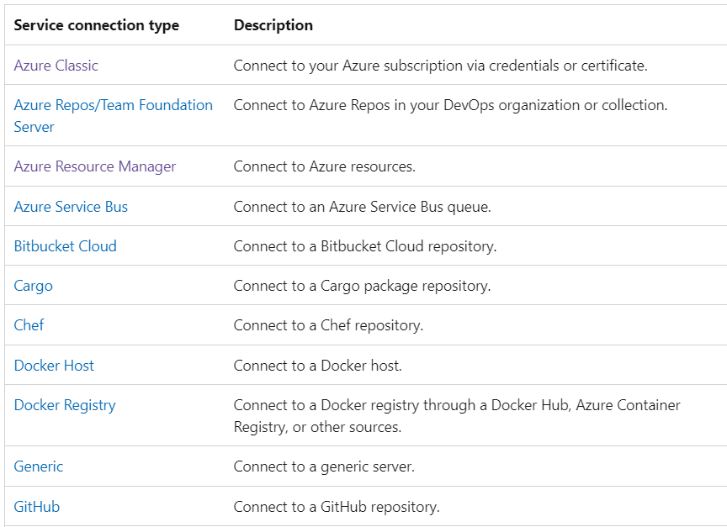
About service connections
      Service connections are authenticated connections between Azure Pipelines and external or remote services that you use to execute tasks in a job.

Slide 21
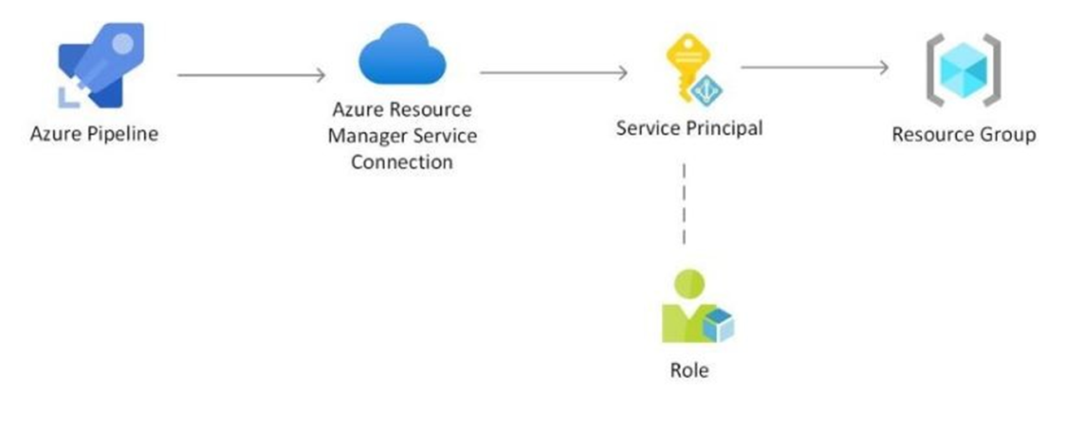
Azure RM Service connection
You can use an Azure Resource Manager service connection to connect to Azure resources such as Azure Key Vault. If you use a Resource Manager service connection, you can use a pipeline to deploy to an Azure resource like an Azure App Service app without authenticating each time.
Easy to be used, just for the tasks input add:
azureSubscription: 'name of the service connection’

Slide 22
Labs – Azure RM service connection + Infrastructure pipeline
Lab1: Create a connection in your organization that we will use to deploy our code to Azure.
Open Day2/Lab1-Service connection.md and follow the instructions.
Lab2: Deploy web app instances using Azure Pipelines, because with pipelines we can deploy also infrastructure.
Open Day2/Lab2-Infrastructure pipeline.md and follow the instructions.

Slide 23
Templates
Templates let you define reusable content, logic, and parameters in YAML pipelines.
Templates can be generated:
at a stage level
at a job level
at a task level
To take full advantage of templates, you should also use template expressions and template parameters.
Template files need to exist on your filesystem at the start of a pipeline run. You can't reference templates in an artifact.
Runtime parameters: defined at start of a pipeline to receive values from user input
Template parameters: defined in any steps, jobs or stage template

Slide 24
Templates reference
# File: azure-pipelines.yml
jobs:
- job: Linux
pool:
vmImage: 'ubuntu-latest’
steps:
- template: templates/include-npm-steps.yml # Template reference
- job: Windows
pool:
vmImage: 'windows-latest’
steps:
- template: templates/include-npm-steps.yml # Template reference

Slide 25
Templates with parameters
jobs:
- template: templates/npm-with-params.yml # Template reference
parameters:
name: Linux
vmImage: 'ubuntu-latest'
- template: templates/npm-with-params.yml # Template reference
parameters:
name: macOS
vmImage: 'macOS-latest'
- template: templates/npm-with-params.yml # Template reference
parameters:
name: Windows
vmImage: 'windows-latest'

Slide 26
Parameters with condition to load a template
#azure-pipeline.yml
parameters:
- name: experimentalTemplate
displayName: 'Use experimental build process?’
type: boolean
default: false
steps:
- ${{ if eq(parameters.experimentalTemplate, true) }}: # Check if 'experimentalTemplate' is true
- template: experimental.yml
${{ if not(eq(parameters.experimentalTemplate, true)) }}: # Check if 'experimentalTemplate' is not true
- template: stable.yml

Slide 27
Lab4 – Convert previous pipelines structure to templates
In this lab we will check our previously pipelines definition and check for any possibility to convert jobs, stages or steps to templates.

Slide 28
Approvals and checks
A pipeline is made up of stages. A pipeline author can control whether a stage should run by defining conditions on the stage. Another way to control if and when a stage should run is through approvals and checks.
Approvals and other checks aren't defined in the yaml file. Users modifying the pipeline yaml file can't modify the checks performed before start of a stage. Administrators of resources manage checks using the web interface of Azure Pipelines.
Approvals: before deploying the application further to production an approval must be received from one of our peers.
Branch control: ensure all the resources linked with the pipeline are built from the allowed branches and that the branches have protection enabled.Example: you can deploy to production stage only from master or release branch.
Branch policies: by enabling branch policies any changes done to selected branch will be made only via pull request with minimum number of reviewers defined, so not via direct commit.
Pipeline deployment approvals - Azure Pipelines | Microsoft Learn

Slide 29

Learning never stops
https://learn.microsoft.com/en-us/training/career-paths/devops-engineer
Build applications with Azure DevOps learning path - Training | Microsoft Learn

